Slide 1


Simple quiz game
Submitted By : Niranjan Chand |Semester 1st | BICT

Slide 2
TABLE OF CONTENT
Introduction------------------------------------------------------------ 1
2. Motivation-------------------------------------------------------------- 2
3. Flowchart--------------------------------------------------------------- 3
4. Future Enhancement------------------------------------------------ 4
5. Output Screen--------------------------------------------------------- 5
6. Reference--------------------------------------------------------------- 9

Slide 3
Introduction
This "QUIZ GAME" project is made to allow users to create and manage a simple database of questions. The software generates the question number automatically, and it is saved in a binary file with the name "QUESTION." Essentially, this database serves as a MASTER file that may be utilized as a look-up table for data like Quiz Option, Sub-menu, either Computer/Mathematics/Science or General and the Return.

Slide 4
MOTIVATION
This project were to create some form of entertainment and to offer some sort of activity in schools and colleges that tests students' general knowledge while also assisting in the acquisition of new knowledge. Because this activity is not readily available everywhere in the world, this small project can assist in testing students' knowledge while also creating entertainment and allowing us.

Slide 5
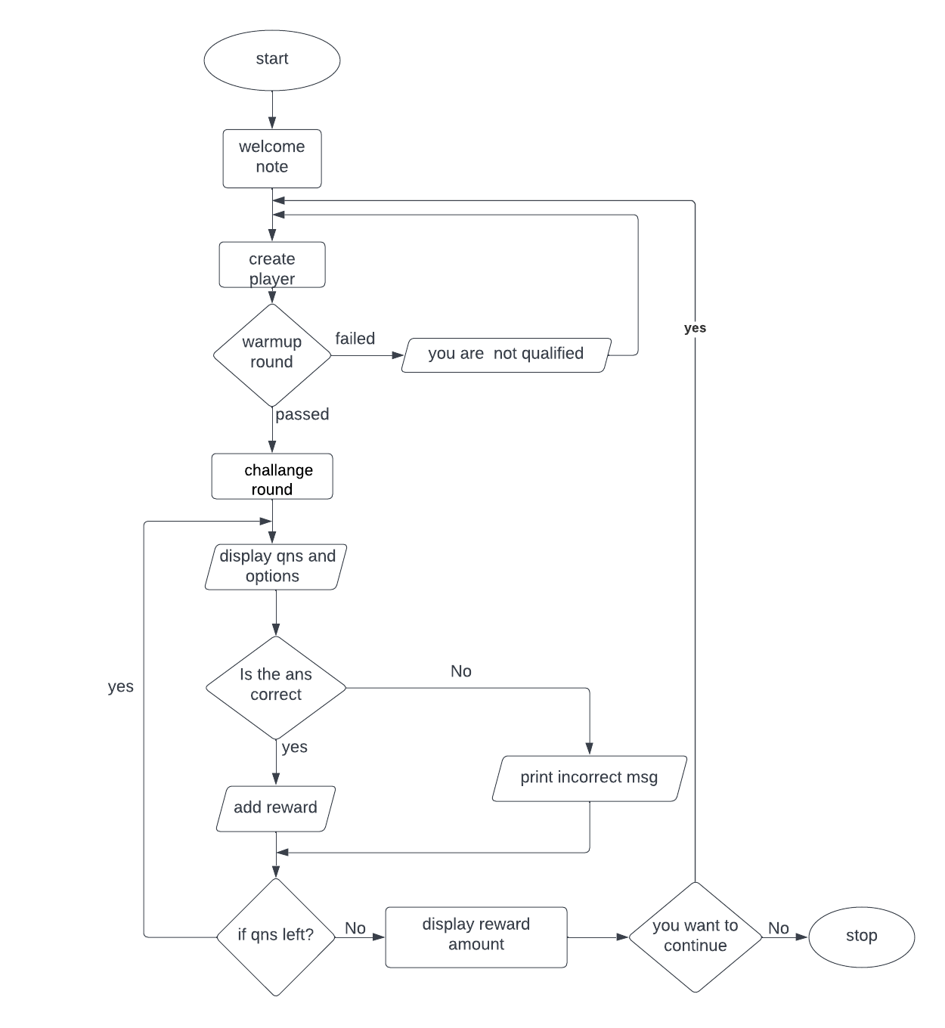
flowchart

Slide 6
FUTURE ENHANCEMENTS
The main aim of our project is create a good interaction between the student and teacher. We are trying to do the project at best level to satisfy all the end users (i.e, student / faculty). And we give the choice to student to add their name under the faculty who they wish and get advice for their betterment. In our future we are decided to provide more security to our website which may not be hacked. We can add printer in future.

Slide 7
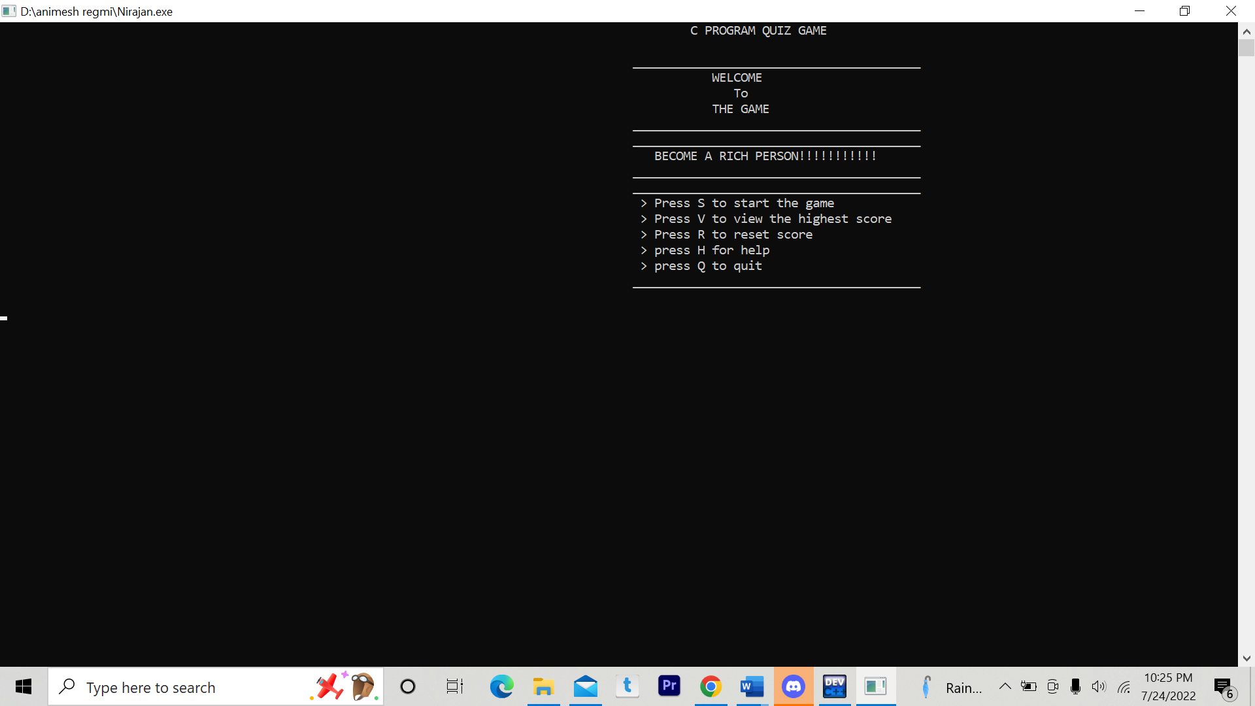
OUTPUT

Slide 8
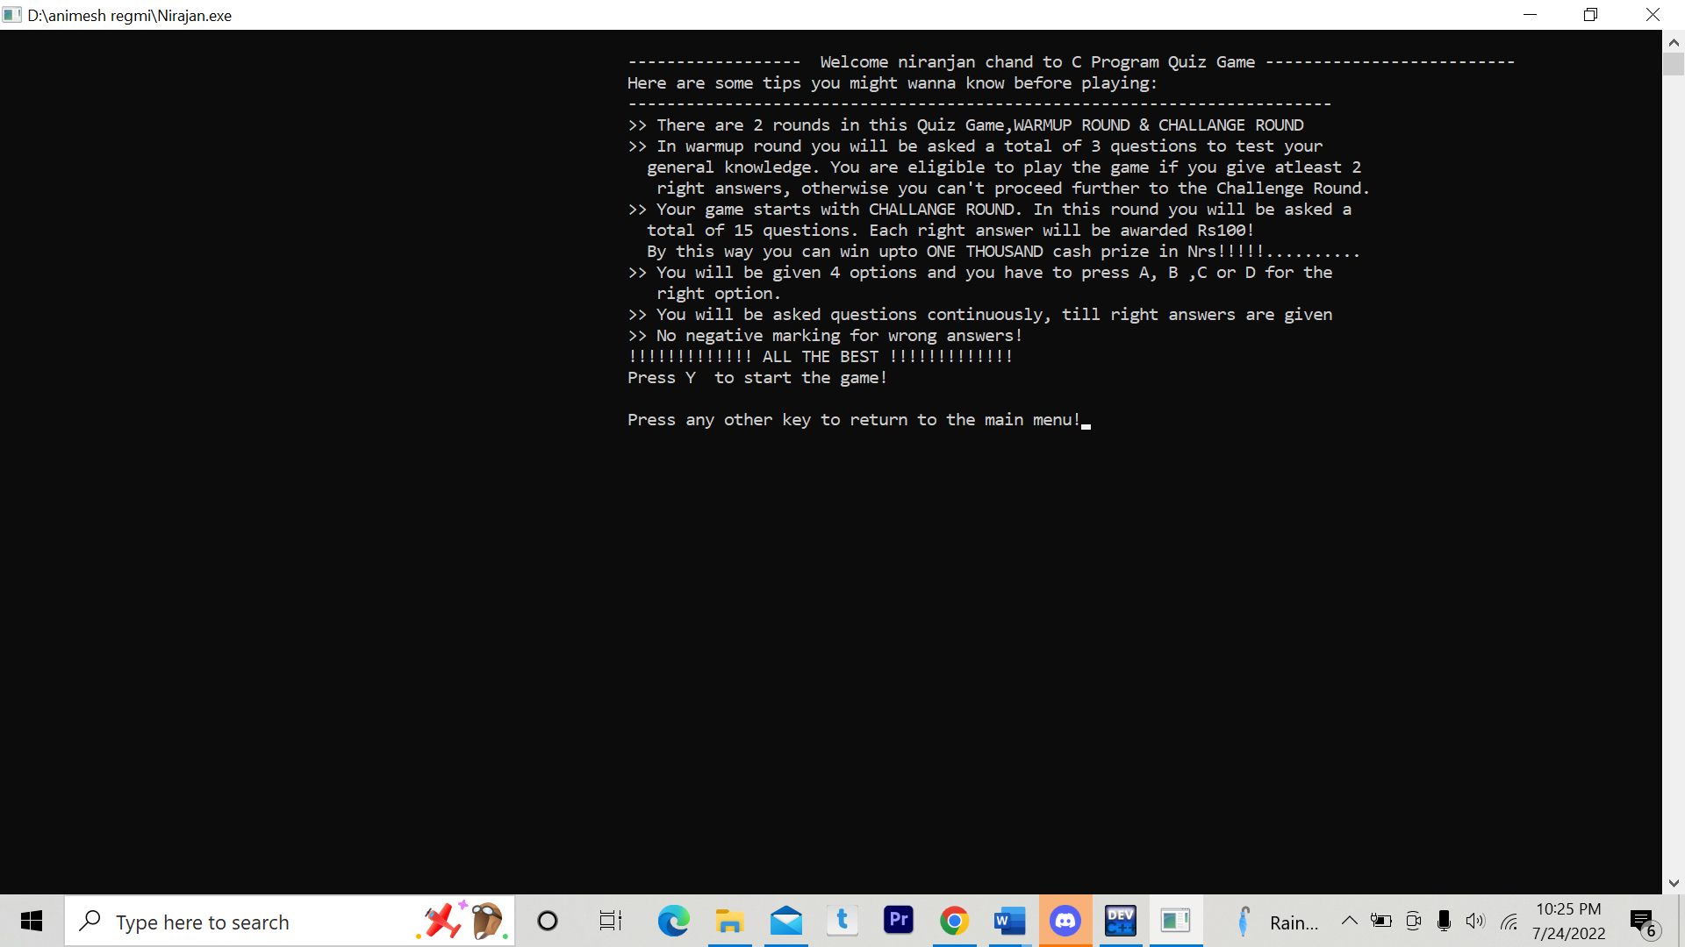
OUTPUT

Slide 9
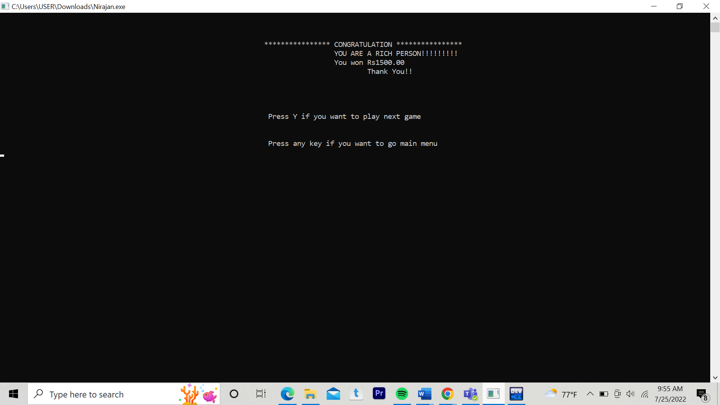
OUTPUT

Slide 10
CONCLUSION
After completion of this project we can play the Quiz game. Students will be benefited with this project. They can test their IQ level and collect some amount of money. This project can be hired by every School for learning purposes. The quiz game designed is very interactive, user friendly and easy to play. The game allows the user to choose the topic of his interest and test his knowledge.

Slide 11
References
(t.thn.). Diambil kembali dari https://www.codewithc.com/quiz-game-mini-project-in-c/
(t.thn.). Diambil kembali dari https://pdfcoffee.com/project-report-final-6-pdf-free.html
(t.thn.). Diambil kembali dari The C++ Programming Language” by Bjarne Stroupstup

Slide 12
Thank you

